Slide 1

Integrated course „Energy Economics“
- Natural Gas Markets
Chair of Energy Systems
Prof. Dr. Boris Heinz | Dr. Elena Timofeeva
elena.timofeeva@tu-berlin.de

Slide 2
Outline
Natural gas reserves and production
Long distance gas pipelines
Gas storage
LNG markets
Wholesale markets for natural gas
Retail gas markets

Slide 3
Dynamics of Gas Market Development
Source: Energy Charter Secretariat (2007) with reference to Konoplyanik

Slide 4
Vertical Integration or Long Term Contracts
© Prof. Dr. Georg Erdmann
Notes:
Long-term contracts are imperfect substitute for vertical integration.

Slide 5
Take-or-Pay Clause in Long Term Contracts
© Prof. Dr. Georg Erdmann

Slide 6
Volume Flexibility Under Long Term Contracts (2007)
Souce: European Commission, Energy sector inquiry 2005-2006

Slide 7
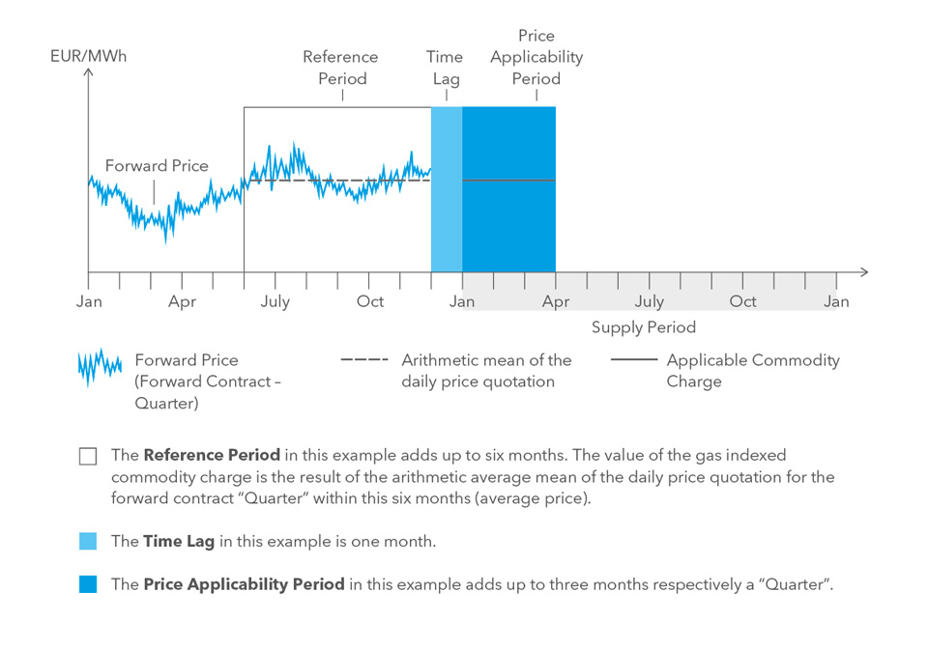
Index-based Gas Price
In this example: 6/1/3 rule
Typical indexation in long-term gas supply contracts: 6/3/3 rule
(6 months reference period; 3 months time lag; 3 months price applicability period)
Time period in or for which (depending on the specific index type) the index is published
Time lag between the reference period and price applicability period
Part of the delivery period to the calculated price applies.
Souce: WINGAS

Slide 8
Price Indexation Under Long Term Contracts (2007)
Souce: European Commission, Energy sector inquiry 2005-2006

Slide 9
Price Indexation by Production Region (2007)
Souce: European Commission, Energy sector inquiry 2005-2006

Slide 10
German Gas Import Prices [monthly mean; source BAFA]
Brent DTD: Platts Dated Brent – physical cargoes of light North Sea crude
oil assigned to specific delivery dates.
© Prof. Dr. Georg Erdmann

Slide 11
Heating Oil Dependency of German Natural Gas Border Prices [monthly mean; source BAFA]
HEL-Rhein – light heating oil Rheinschiene
© Prof. Dr. Georg Erdmann

Slide 12
Heating Oil Dependency of German Natural Gas
Border Prices [monthly mean; source BAFA]
© Prof. Dr. Georg Erdmann

Slide 13
US Heating Oil and Natural Gas Price [Data source: DOE 2010]
© Prof. Dr. Georg Erdmann

Slide 14
Gas Extraction in the US [lower 48 states, source: EIA]
© Prof. Dr. Georg Erdmann

Slide 15
Gas and Heating Oil Prices
© Prof. Dr. Georg Erdmann

Slide 16
Analysis of Non-stationary Time Series
© Prof. Dr. Georg Erdmann

Slide 17
Error Correction Model
© Prof. Dr. Georg Erdmann

Slide 18
Test of Statistical Significance
© Prof. Dr. Georg Erdmann

Slide 19
Downside of Long Term Contracts
Lacking transparency
Reduced liquidity on wholesale markets
Barrier for entry for new competitors

Slide 20
Oil-product linked gas prices
Initial rationale for oil-based indexation is that users can choose between burning gas and oil products.
Early liberalised gas markets of the US and the UK with a liquid wholesale trading in natural gas resulted into gas-to-gas competition.
Long-term supply contracts for Continental Europe were initially linked to oil prices.
Since late 2000s European gas markets have shifted significantly from oil indexation towards hub-linked prices.
Renegotiation of price formulas in long-term supply contracts followed.

Slide 21
LTC Renegotiation
Driving factors for transition to hub-linked gas prices:
US shale gas production
Qatari LNG available in Europe
Reduction in gas demand
Gas importers stayed bound by LTC at oil-linked prices incurring losses.
Renegotiation of LTC followed to introduce hub indexation.
Trends in newly signed contracts:
→ shorter duration period (10-15 years)
→ full hub indexation
→ new buyer/seller balance

Slide 22
Evolution of TTF and German Import Contract Prices
TTF (Title Transfer Facility) – Dutch gas hub
BAFA – average German import contract
Source: Franza, CIEP (2014), with reference to DEPA

Slide 23
Third-Party Access to Gas Infrastructure
Non-discriminatory (effective and transparent) access to gas transportation systems is a crucial prerequisite for a liquid market for natural gas.
Unbundling for gas TSOs (see EU Gas Directive 2009/73/EC):
Transmission and distribution activities are separated from the rest of the value chain
Ownership unbundling
Independent system operator (ISO)
Independent transmission operator (ITO)
Certification to ensure compliance with unbundling requirements for transmission system owner or TSO controlled by person(s) from third country(ies)
„Gazprom clause“
See lecture 10
on unbundling: equivalent rationale and requirements apply for the gas sector.

Slide 24
Gas Network Access Models
Point-to-point system
gas traders book specific transportation route from an entry to an exit point
distance-based capacity pricing
Entry-exit system
entry and exit capacities are booked separately
entry fee and exit fee – capacity pricing independent of distance
traders with entry capacities can sell gas to traders with exit capacities
each exit point can be supplied from any entry point
Entry-exit system enables wholegas gas trading on virtual trading point (virtual hub) / market area level: gas is traded independently of its location in a market area.

Slide 25
Key Elements of Network Access Model
Overall
objective
Non-discriminatory network access to facilitate competition
Areas of
network
access
General network access model
Capacity and congestion management
Balancing
Options/
major
determinants
Entry-exit
Point-to-point
Postage stamp
Allocation principles
Capacity products
Further rules/incentives
Balancing period
Imbalance pricing
Flexibility market
Source: Hewicker & Kesting, in: Handbook Utility Management, 2009
Notes:
In point-to-point model imbalance under each contract is priced.
In entry-exit model net imbalance is considered.

Slide 26
Point-to-point Model
Entry
Contract Path
Network
Shippers specify entry and exit points and the transportation path.
Actual physical flow may differ from the contracted path.
Entry and exit capacities cannot be separated from each other and from the gas (commodity) transaction.
Exit
Source: Hewicker & Kesting, 2009

Slide 27

Entry-exit Model
Entry
Entry
7
5
Exit
4
Exit
Exit
10
Exit
12
Entry
10
5
Shippers book entry and exit capacity independently from each other.
No need to specify transportation path or distance.
Contracts for entry and exit capacities are independent from each other and from commodity transactions.
Entry and exit tariffs are set independently for each entry/exit point
Different tariffs for each point
All network operators in a network zone cooperate and set tariffs on a cost-reflective basis.
Source: Hewicker & Kesting, 2009
Notes:
Point-specific tariffs should, ideally, reflect the cost of capacity extension required to eliminate congestion.

Slide 28
European gas regions, markets and hubs
Source: OIES (2017) with reference to www.worldatlasbook.com and P. Heather

Slide 29
Gas Hubs
Physical gas hub, e.g.
Henry Hub (USA) – connecting point of 14 pipelines
Zeebrugge (Belgium)
Baumgarten (CEGH, Austria)
Virtual gas hub, e.g.
NBP, National Balancing Point (UK)
TTF, Title Transfer Facility (Netherlands)

Slide 30
Physical gas hubs: Baumgarten
Major physical pipeline interconnection point in the near Slovakian border
13 physical locations (flanges)
Wheeling services provided by CEGH
1/3 of gas imports from Russia to Western Europe
Source: Heather, OIES (2012) with reference to CEGH Exchange

Slide 31
Virtual Gas Hubs: Austrian Virtual Trading Point (VTP)
Source: Heather, OIES (2012) with reference to E-Control

Slide 32
Forms of Gas Trading
Motivations to trade:
Balancing physical portfolio (asset-backed)
Financial hedge
Speculation (merchant/proprietary)

Slide 33
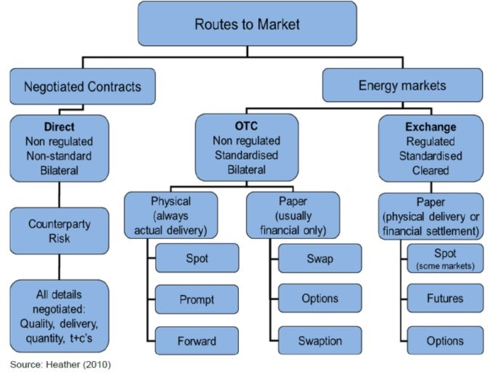
Forms of Gas Trading

Slide 34
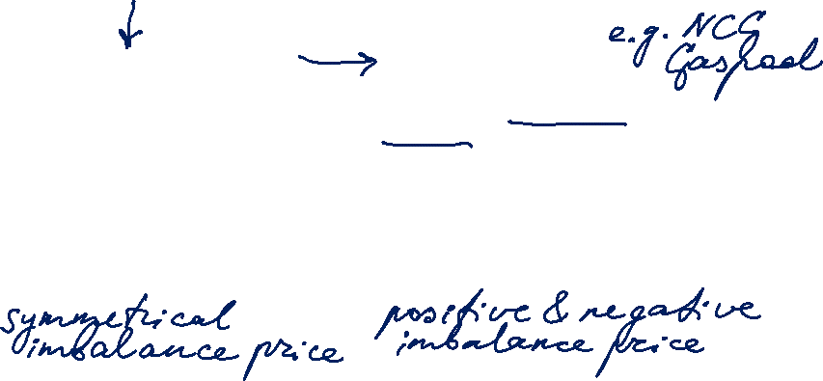
Comparison Electricity – Gas
Electricity Market
Transmission system operator (TSO)
Balance group coordinator
Distribution system operator (DSO)
Control area
BG per control area
Balance Responsible Party (BRP)
SLP and RLM customers
Gas Market
Transmission system operator (TSO)
Market area coordinator
Regional and local system operators (DSO)
Market area / Virtual trading point
BG per market area
Balance Responsible Party (BRP)
SLP and RLM customers
© Adapted from Prof. Dr. Georg Erdmann

Slide 35
Structure of the Value Chain
© Prof. Dr. Georg Erdmann

Slide 36
Companies Along the Value Chain
© Prof. Dr. Georg Erdmann

Slide 37
Incumbent’s standard gas offers for households in EU capitals – Nov/December 2018 [%]
Source: ACER/CEER, 2018

Slide 38
Pass-through in gas retail market at EU level
Responsiveness of the energy component of the retail prices to changes in wholesale prices and evaluation of mark-ups in the household segments from 2012 to 2018
Source: ACER, 2018

Slide 39
Backup: Emergency Stockpiling – Strategic Gas Reserve
© Prof. Dr. Georg Erdmann

