Slide 1
Integrated course „Energy Economics“ - Exam Preparation: Old Tasks
Chair of Energy Systems
Prof. Dr. Boris Heinz | Dr. Elena Timofeeva
elena.timofeeva@tu-berlin.de

Slide 2
Exam on Friday, 28.02.2020 8:00 – 10:30 hrs at H 0104
Exam
6 ECTS for a written exam of 90 minutes
Subjects
„Theoretical questions“ based on the lecture
„Calculation based questions“ based on the tutorial
Registration
If possible, use QISPOS
Free choice and supplementary modules: Examination office
Erasmus: Mail with name, matriculation number to elena.timofeeva@tu-berlin.de
Please do not register multiple ways
Exam review
In the second week of the new semester SoSe 20 (20.04.2020 – 24.04.2020)

Slide 3
Exam Preparation
Consultation hour
Thursday, 13.02.2019 12-14 hrs, HFT-TA 101

Slide 4
Exam on Friday, 28.02.2020 8:00 – 10:30 hrs at H 0104
Please wait outside the H 0104 before the exam.
Material:
Allowed: ID-Card or Passport, Student-ID-Card, writing and drawing utensils, water bottle, scientific calculator (non-programmable and non-graphic)
Not allowed: Mobile phones, bags and jackets
Exam:
Writing paper will be provided.
There will be time to read and room for questions before the actual exam. During this, writing is not allowed.
We will check attendance during the exam. Please have your ID-card and your student ID-card ready.
Please notify us with a hand sign if you have a question, need to use the restroom or need any other assistance.
Early submissions are possible until 15 minutes before the end.
Check your examination regulation if you do not feel well on the day of the exam to get officially deregistered.

Slide 5
Final Exam: Energy Economics Winter Term 2017/18 February 26, 2019
Task 1: 22 points
Task 2: 15 points
Task 3: 18 points
Task 4: 09 points
Task 5: 16 points
Task 6: 20 points

Slide 6
Task 1) Energy Balances
a) Explain the terms primary, secondary, final and useful energy using the example of energy conversion from “lignite coal” to “light” (room lighting). [3]
b) What is the major energy carrier in the public thermal electricity generation? (Exact description, absolute number (TJ) and share (%)) [3]

Slide 7
Task 1) Energy Balances
For the following questions, please refer to the attached German energy balance from 2016 (source: AG Energiebilanzen).
Which share of lignite coal in the energy supply is imported? [1]
What is the major energy carrier in district heating? (Exact description, absolute number (TJ) and share (%)) [3]

Slide 8
Task 1) Energy Balances
For the following questions, please refer to the attached German energy balance from 2016 (source: AG Energiebilanzen).
What is the average efficiency of district heating stations? [2]
What is the share of renewable electricity generation in the gross electricity production? [2]

Slide 9
Task 1) Energy Balances
For the following questions, please refer to the attached German energy balance from 2016 (source: AG Energiebilanzen).
What are the average full load hours of lignite power stations (as a component of “Public thermal power stations”)? Assume an average efficiency of lignite power stations of 34 % and an installed capacity of 21 GW in 2016. [5]

Slide 10
Task 1) Energy Balances
A heat pump uses electricity and ambient heat for space heating. In 2016, 9 100 TJ electricity were used in heat pumps in households. The coefficient of performance (COP) indicates the ratio of generated space heat to the used electricity. A typical value for the COP is 300 %.
Which element of the energy balance includes the electricity consumption of heat pumps in households? Name the respective row number and column label. [1]
Why is the efficiency indicator of a heat pump (the COP) higher than 100 %? [2]

Slide 11
Task 1) Energy Balances
A heat pump uses electricity and ambient heat for space heating. In 2016, 9 100 TJ electricity were used in heat pumps in households. The coefficient of performance (COP) indicates the ratio of generated space heat to the used electricity. A typical value for the COP is 300 %.
The dominant space heating technology is natural gas heating (efficiency of a condensing boiler: 95 %). How much final energy consumption of natural gas of households is replaced by heat pumps (absolute number and share)? [3]

Slide 12
Task 2) Supply and Demand
You have derived supply and demand functions for a product in a competitive market:
Demand $Q_{D}\left(p\right)=−0.4∗p+70$ Price $p$ in $MU/QU$
Supply $Q_{S}\left(p\right)=0.6∗p+10$ Quantity $Q$ in $QU$
a) Draw the supply and demand function and highlight the market equilibrium. [3]

Slide 13
Task 2) Supply and Demand

Slide 14
Task 2) Supply and Demand
You have derived supply and demand functions for a product in a competitive market:
Demand $Q_{D}\left(p\right)=−0.4∗p+70$ Price $p$ in $MU/QU$
Supply $Q_{S}\left(p\right)=0.6∗p+10$ Quantity $Q$ in $QU$
b) Find the market clearing price (MCP) and the market clearing volume (MCV) graphically and mathematically. [3]

Slide 15
Task 2) Supply and Demand
You have derived supply and demand functions for a product in a competitive market:
Demand $Q_{D}\left(p\right)=−0.4∗p+70$ Price $p$ in $MU/QU$
Supply $Q_{S}\left(p\right)=0.6∗p+10$ Quantity $Q$ in $QU$
c) What is the price elasticity of the demand in the market equilibrium? Is it elastic or inelastic? [3]

Slide 16
Task 2) Supply and Demand
You have derived supply and demand functions for a product in a competitive market:
Demand $Q_{D}\left(p\right)=−0.4∗p+70$ Price $p$ in $MU/QU$
Supply $Q_{S}\left(p\right)=0.6∗p+10$ Quantity $Q$ in $QU$
d) How much is consumer surplus (CS) and how much is producer surplus (PS)? Hatch the corresponding areas in the sketch. [3]

Slide 17
Task 3) Internalization of external effects – Carbon tax
Explain the term negative external effect. [2]
How can the introduction of a carbon tax lead to an internalization of external costs of CO2 emissions? [4]

Slide 18
Task 3) Internalization of external effects – Carbon tax
c) What is meant by the term Carbon Leakage in connection with the introduction of a CO2 tax? [2]

Slide 19

Task 3) Internalization of external effects – Carbon tax
The industry of the country Cleanland emits 150 Million tonnes of CO2. The following formula shows the total CO2 abatement cost function.
$K\left(x\right)=−0.025∙x^{3}+3∙x^{2}−60∙x for x∈\left[0, 50\right]$
$K(x)$: total cost of abatement in Million € and
$x$: abatement in Million t CO2
d) Calculate the industry’s cost to abate 40 Million t CO₂. [2]

Slide 20

Task 3) Internalization of external effects – Carbon tax
The industry of the country Cleanland emits 150 Million tonnes of CO2. The following formula shows the total CO2 abatement cost function.
$K\left(x\right)=−0.025∙x^{3}+3∙x^{2}−60∙x for x∈\left[0, 50\right]$
$K(x)$: total cost of abatement in Million € and
$x$: abatement in Million t CO2
e) What are the average costs of abatement in €/t CO₂? [2]

Slide 21
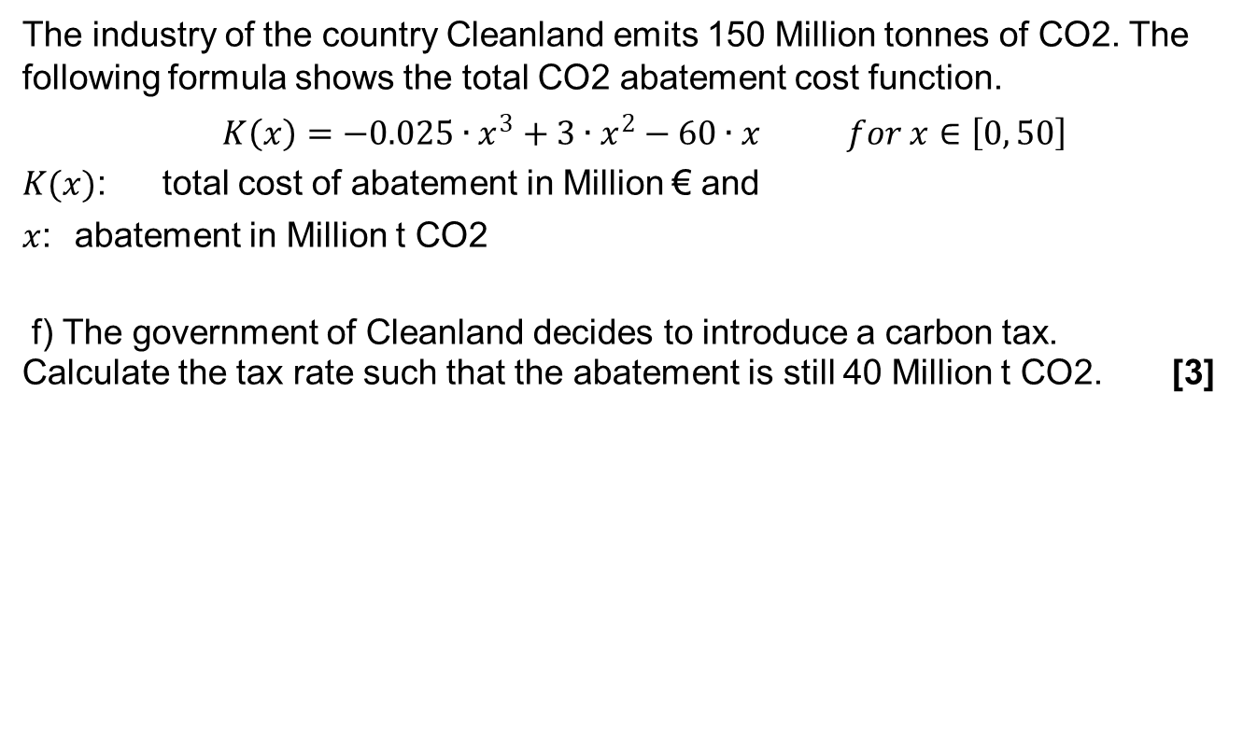
Task 3) Internalization of external effects – Carbon tax
The industry of the country Cleanland emits 150 Million tonnes of CO2. The following formula shows the total CO2 abatement cost function.
$K\left(x\right)=−0.025∙x^{3}+3∙x^{2}−60∙x for x∈\left[0, 50\right]$
$K(x)$: total cost of abatement in Million € and
$x$: abatement in Million t CO2
f) The government of Cleanland decides to introduce a carbon tax.
Calculate the tax rate such that the abatement is still 40 Million t CO2. [3]

Slide 22
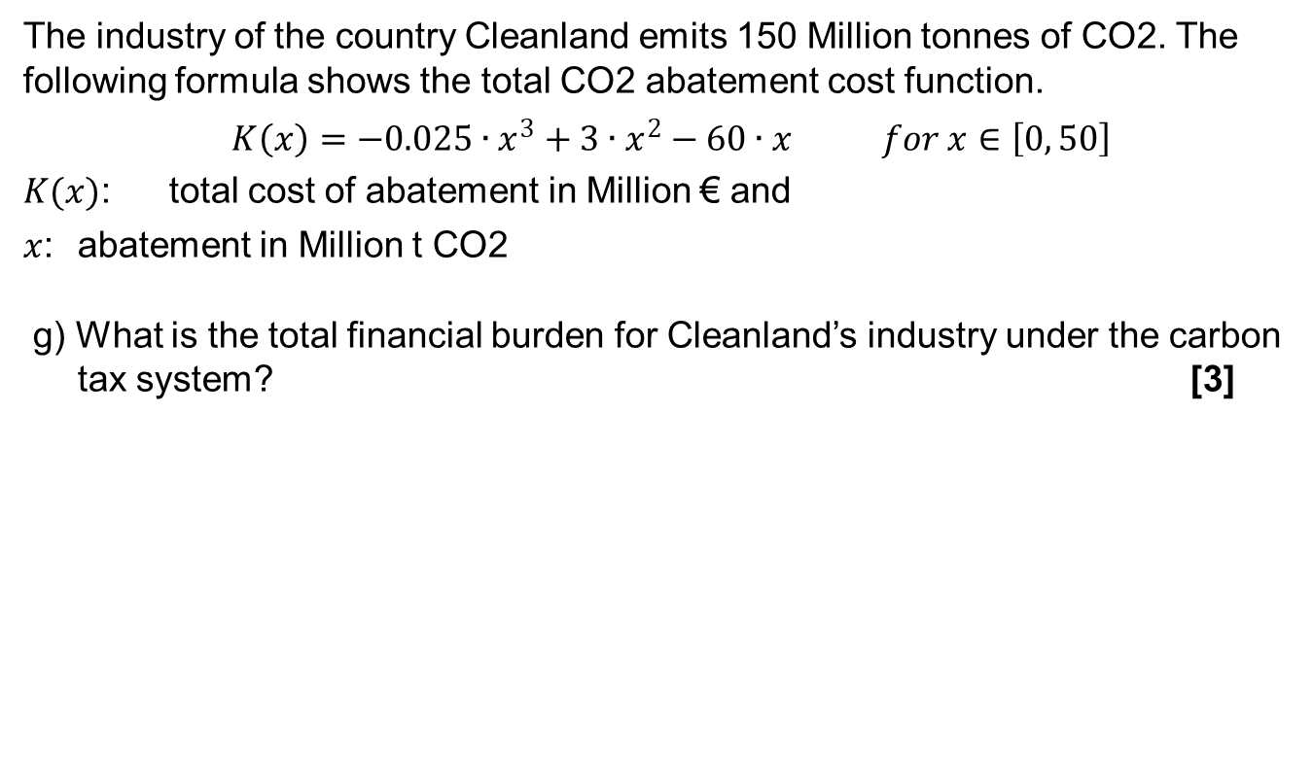
Task 3) Internalization of external effects – Carbon tax
The industry of the country Cleanland emits 150 Million tonnes of CO2. The following formula shows the total CO2 abatement cost function.
$K\left(x\right)=−0.025∙x^{3}+3∙x^{2}−60∙x for x∈\left[0, 50\right]$
$K(x)$: total cost of abatement in Million € and
$x$: abatement in Million t CO2
g) What is the total financial burden for Cleanland’s industry under the carbon tax system? [3]

Slide 23
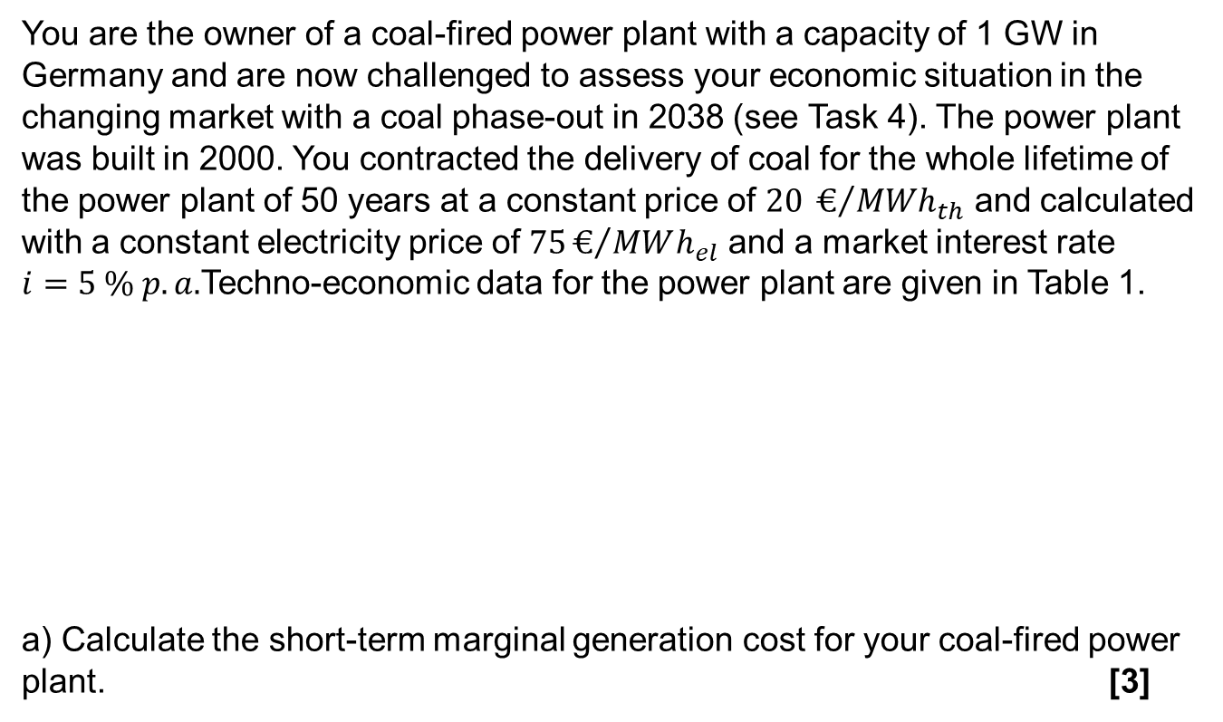
Task 4) Coal phase-out – Capital Budgeting
You are the owner of a coal-fired power plant with a capacity of 1 GW in Germany and are now challenged to assess your economic situation in the changing market with a coal phase-out in 2038 (see Task 4). The power plant was built in 2000. You contracted the delivery of coal for the whole lifetime of the power plant of 50 years at a constant price of $20 €/{{MWh}_{th}}$ and calculated with a constant electricity price of $75€/{MWh_{el}}$ and a market interest rate $i=5 \% p.a.$Techno-economic data for the power plant are given in Table 1.
a) Calculate the short-term marginal generation cost for your coal-fired power plant. [3]
Investment | Full load hours | Fuel price | CO₂ Price | Efficiency | Emission factor coal | O&M Cost
[$\frac{Euro}{{MW}_{el}}$] | [$\frac{h}{a}$] | [$\frac{€}{{MWh}_{th}}$] | [$\frac{Euro}{t_{CO2}}$] | [%] | [$\frac{{t CO2}_{2}}{{MWh}_{th}}$] | [$\frac{Euro}{{MW}_{el}∙a}$]
1.000.000 | 5.000 | 20 | 10 | 40 | 0,38 | 20.000

Slide 24
Task 4) Coal phase-out – Capital Budgeting
a) Calculate the short term marginal generation cost for your coal-fired power plant. [3]

Slide 25
Task 4) Coal phase-out – Capital Budgeting
a) Calculate the short-term marginal generation cost for your coal-fired power plant. [3]

Slide 26
Task 4) Coal phase-out – Capital Budgeting
You contracted the delivery of coal for the whole lifetime of the power plant of 50 years at a constant price of $20 €/{{MWh}_{th}}$ and calculated with a constant electricity price of $75€/{MWh_{el}}$ and a market interest rate$i=5 \% p.a.$
b) Was the whole investment profitable? Calculate the net present value (NPV) to answer the question. The capital recovery factor $CRF\left(5 \% p.a.,50 a\right)=0.05478 a^{−1}$. [5]

Slide 27
Task 4) Coal phase-out – Capital Budgeting
d) You are outraged by the coal phase-out since your power plant will have to shut down already in 2035 and therefore plan on suing the government for your loss of profit from regular operations. What would be a lump-sum offer you could accept in 2035 and what is the present value for 2019 of this amount? Hint: The capital recovery factor $CRF\left(5 \% p.a.,15 a\right)=0.09635 a$. [5]

Slide 28

Task 4) Coal phase-out – Capital Budgeting
d) What would be a lump-sum offer you could accept in 2035 and what is the present value for 2019 of this amount?$CRF\left(5 \% p.a.,15 a\right)=0.09635 a$

Slide 29
Task 5) Coal phase-out – Hotelling’s rule
It is decided to phase out the extraction of coal and coal-fired electricity generation by 2038.
a) The forced earlier depletion time is expected to have an effect on the future extraction path and the price path of coal. Qualitatively describe this effect. Support your explanation with a fully labeled sketch of Hotelling’s rule in four quadrants. [6]

Slide 30
Task 5) Coal phase-out – Hotelling’s rule

Slide 31
Task 5) Coal phase-out – Hotelling’s rule

Slide 32
Task 5) Coal phase-out – Hotelling’s rule

Slide 33
Task 6) Credit Risk Exposure
There are two energy trading companies – Company A and Company B – dealing with each other on the over-the-counter (OTC) energy market.
As of 03.03.2019 there is one outstanding (not yet fully performed) physical gas trading transaction concluded on 20.12.2018 with the following terms:
Seller: Company B
Buyer: Company A
Delivery Point: TTF* (*Title Transfer Facility – Dutch virtual gas trading point/hub)
Contract Quantity: 5 MWh** (**5 MWh to be delivered in each hour of the Total Supply Period)
Total Supply Period: From 06:00 hours on 01/01/2019
to 06:00 hours on 01/04/2019
Contract Price: 14,386 €/MWh
Market prices on 03.03.2019 are as follows:
TTF Balance of Month: 11,942 €/MWh
a) What is the mark-to-market value of the transaction for Company B on 03.03.2019 (in €/MWh)?

Slide 34
Task 6) Credit Risk Exposure
b) What is Company B’s credit risk exposure under the transaction on 03.03.2019?

Slide 35
Task 6) Credit Risk Exposure
b) What is Company B’s credit risk exposure under the transaction on 03.03.2019?
For simplification assume that replacement delivery from 6:00 CET on 04/03/2020 to 6:00 CET onwards will be contracted as a Balance of Month contract. Assume that physical delivery stopped at 6:00 CET on 04/02/2020.
Product: Q4 2019
t

Slide 36
Task 6) Credit Risk Exposure
b) What is Company B’s credit risk exposure under the transaction on 03.03.2019? Contract price: 14,386 €/MWh
Market price: 11,942 €/MWh

Slide 37
Task 7) PV based self-supply
A friend of yours considers the installation of a PV-system on the rooftop of his house in Germany. He heard that you attended the Energy Economics class at university and is asking you for advice regarding his decision. He provides you with data about his daily electricity consumption and the expected daily infeed of the PV-system (see Figure 1). On a typical day 15.2 kWh are consumed by the household and 9 kWh generated by the PV-system. For simplification assume that the given data characterizes all 365 days of the year. In addition, you are given assumptions for the cost of the proposed PV system, the expected Feed-in-tariff (FIT) and the retail price which is paid for electricity (see below table).

Slide 38
Task 7) PV based self-supply
On a typical day 15.2 kWh are consumed by the household and 9 kWh generated by the PV-system.
How much is the yearly electricity bill without the PV-system? [2]
Calculate the PV-system’s yearly full load hours (FLH) for the proposed location. [2]
Qualitatively compare FLH found in b) with FLH of a baseload power plant. Explain the difference. [2]

Slide 39
Task 7) PV based self-supply
d) Please calculate the PV-system’s levelized cost of electricity (LCOE). Is the investment in the PV system profitable if all electricity is sold for the given Feed-in tariff (FIT)? Answer this question based on your calculated LCOE. [5]

Slide 40
Task 7) PV based self-supply
c) Please calculate the PV-system’s levelized cost of electricity (LCOE). Is the investment in the PV system profitable if all electricity is sold for the given Feed-in tariff (FIT)? Answer this question based on your calculated LCOE. [5]

