Slide 1
Integrated course „Energy Economics“
- Financial Management
Chair of Energy Systems
Prof. Dr. Boris Heinz | Dr. Elena Timofeeva
elena.timofeeva@tu-berlin.de

Slide 2
Outline
Fundamentals of finance: Balance sheet model of the firm
Time value of money: Compounding, discounting, annuity
Capital structure and cost of capital
Capital budgeting: NPV method
NPV vs IRR
Levelised cost of electricity (LCOE)
Real options

Slide 3
Internal rate of return
IRR is the value of interest rate i such that NPV = 0.
NPV rule: NPV > 0
IRR rule:* IRR > WACC (opportunity cost of capital)
for mutually exclusive projects: choose the highest IRR
NPV vs. IRR:
amount of surplus vs. percentage return / break-even point
absolute return vs. relative return
* for projects with an initial negative cash flow and subsequent positive cash flows

Slide 4
NPV and IRR
Example:
I₀ = 5 Mio. €
oc = 200‘000 € / a
Q = 500‘000 units
p = 1,70 € / unit
T = 20 years
NPV [1000 €]
1500
IRR: internal rate of return
1000
500
0,07
0,08
0,09
0,1
0,11
0,12
0,13
Interest rate
-500

Slide 5
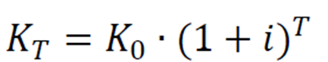
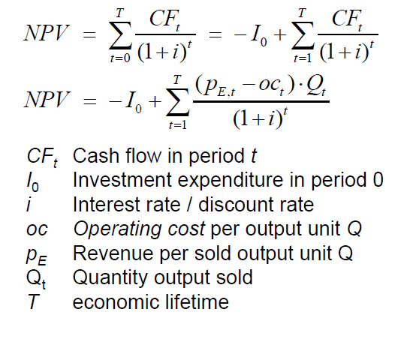
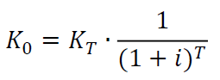
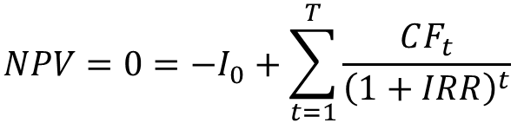
Recap: Time value of money, NPV and IRR
Compounding:
Net Present Value:
Discounting:
IRR:
$$NPV=0=−I_{0}+\sum_{t=1}^{T}{\frac{CF_{t}}{{\left(1+IRR\right)}^{t}}}$$
K = Capital
i = Interest rate / Discount rate
T = Time horizon / Economic lifetime
K₀ = Present value
K_{T} = Value at the Time horizon
CF_{t} = Cash Flow in period t
I₀ = Investment in period 0
i = Interest rate / Discount rate
T = Time horizon / Economic lifetime
t = Period

Slide 6
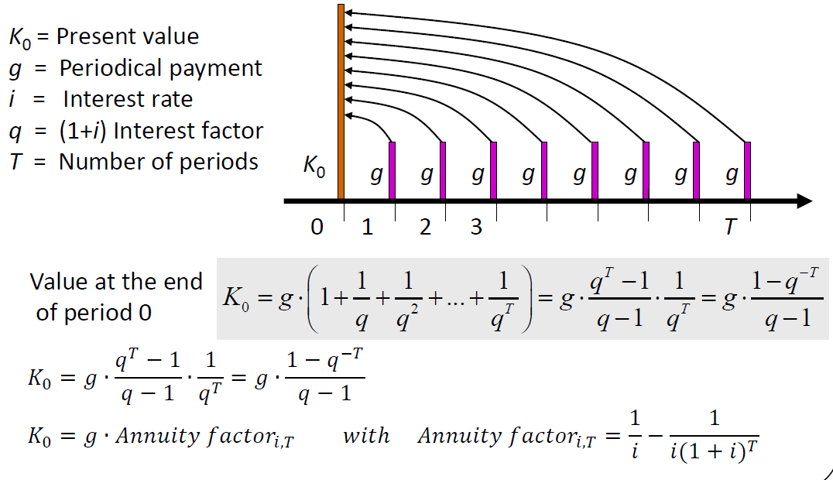
Recap: Annuity
Annuity is a level stream of regular payments during a fixed number of periods.
Notes:
Regular cashflows are uncommon in the energy sector but nevertheless used for simplification.
The formula values the annuity as of one period before the first payment.

Slide 7
Annuity factor
Notes:
Used to calculate PV of annuity

Slide 8
Capital recovery factor
Notes:
Constant annual amount needed to repay a loan amount.
Annual capital user cost.

Slide 9
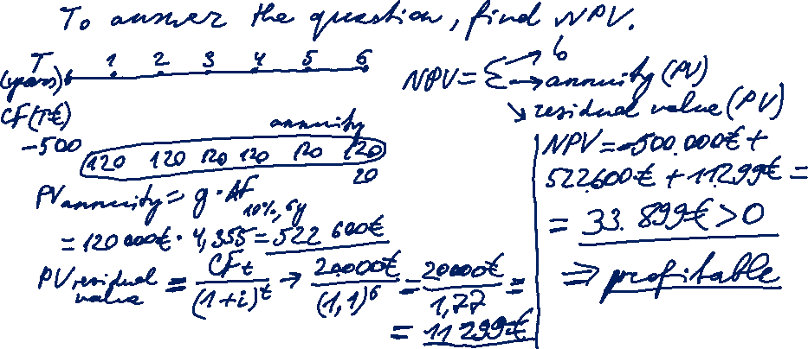
Task 1) NPV and IRR
A company in the waste disposal sector plans to buy a garbage truck to transport waste from a landfill to a waste incineration plant. The truck costs 500 000 €. Due to the operation of the truck, an annual constant cash flow of 120 000 € is estimated. The estimated lifetime of the truck is 6 years, after this period its residual value is 20 000 €.
Is the investment profitable? (Assuming an interest rate of 10%)?

Slide 10
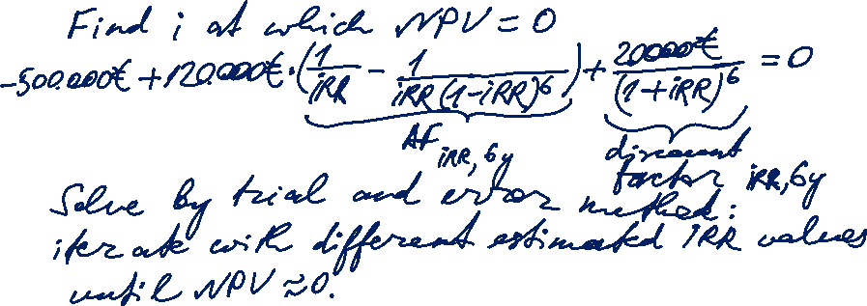
Task 1) NPV and IRR
A company in the waste disposal sector plans to buy a garbage truck to transport waste from a landfill to a waste incineration plant. The truck costs 500 000 €. Due to the operation of the truck, an annual constant cash flow of 120 000 € is estimated. The estimated lifetime of the truck is 6 years, after this period its residual value is 20 000 €.
What is the Internal Rate of Return (IRR)?

Slide 11
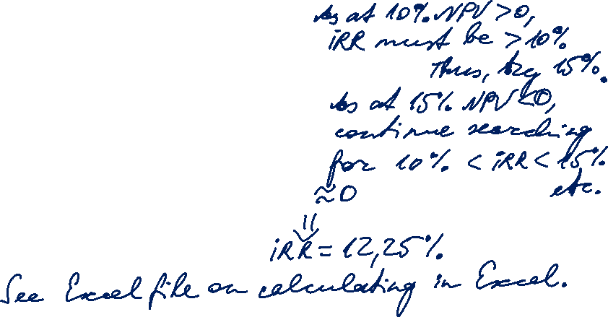
Task 1) NPV and IRR
A company in the waste disposal sector plans to buy a garbage truck to transport waste from a landfill to a waste incineration plant. The truck costs 500 000 €. Due to the operation of the truck, an annual constant cash flow of 120 000 € is estimated. The estimated lifetime of the truck is 6 years, after this period its residual value is 20 000 €.
What is the Internal Rate of Return (IRR)?
i | NPV (€)
10% | 33.920
15% | -37.215
12% | 1000
12,25% | -160

Slide 12
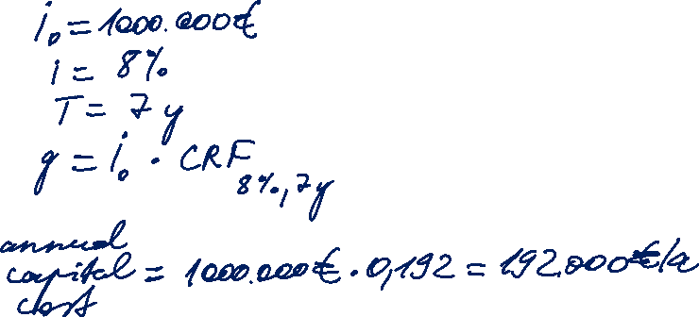
Task 2) Break even and Production threshold
The investment costs for a production plant are 1 Mio. €. The capacity of the production plant is 100 units per year, with variable costs per unit being 80 €. The estimated lifetime of the production plant is 7 years. Assume an interest rate of 8%.
How much are the annual capital costs?

Slide 13
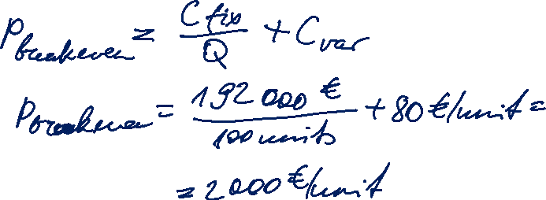
Task 2) Break even and Production threshold
The investment costs for a production plant are 1 Mio. €. The capacity of the production plant is 100 units per year, with variable costs per unit being 80 €. The estimated lifetime of the production plant is 7 years. Assume an interest rate of 8%.
At which price is the production profitable?

Slide 14
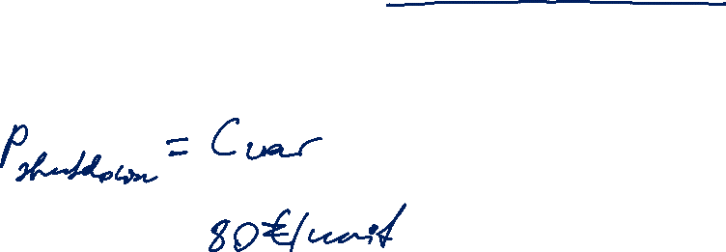
Task 2) Profit threshold and Production threshold
The investment costs for a production plant are 1 Mio. €. The capacity of the production plant is 100 units per year, with variable costs per unit being 80 €. The estimated lifetime of the production plant is 7 years. Assume an interest rate of 8%.
At which price is the production threshold reached?

Slide 15
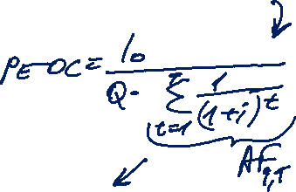
Levelised cost of electricity (LCOE)
Generic formula:
For electricity generation: CF are derived from operating cost and revenues from selling electricity
  oc operating cost per unit of energy Q
  p_{E} revenue per unit of energy Q
  Q total amount of electricity output over lifetime
Solving for p_{E} results in levelised cost of electricity (LCOE):
I₀
p_{E} = + oc
Q ∙ AF_{i,T}
Notes:
Least cost approach > LCOE

Slide 16
Levelised cost of electricity (LCOE)
lifetime costs divided by
lifetime electricity output
Lifetime costs: PV of total cost of building and operating
LCOE allows comparison of technologies regardless of lifetime, installed capacity, cost of capital, risk and return.
initial capital cost*
* specific investment costs: investment costs divided by capacity
annual operating expenses
capacity factor
discount rate
operational life
Notes:
LCOE is the present value of the revenue from produced electricity over the economic life of the plant and the costs incurred in the construction, operation and maintenance, and the fuel costs.

Slide 17

Levelised cost of electricity (LCOE)
How to calculate the generation costs per unit of electricity?
I₀ ∙ CRF_{i, t}
LCOE = + oc
Q
E_{t} = Cap * FLH
  E_{t} annual electricity output
  Cap installed capacity (rated power)
  FLH full load hours: annual output divided by Cap
E_{t} [kWh]
Capacity factor =
Cap [kW] * 8.760h
Notes:
Generation costs of wind depend on lifetime, interest rate, investment and operation costs and full load hours.

Slide 18

Task 3) NPV and Levelized Cost of Energy (LCOE)
The table below describes the investment conditions for a 5 kW_{peak} PV system in Germany and in Spain:
What is the Net Present Value (NPV) of the investment in Spain and in Germany, given a feed-in tariff (FIT) of 11.83 ct/kWh?
What are the levelised cost of electricity (LCOE) of the photovoltaic system in Germany and in Spain (LCOE = electricity generation costs in ct/kWh based on full costing)?
Assume that electricity retail prices in Spain and Germany are 29 ct/kWh. What does your result in b) imply for the self-consumption of the generated electricity?
Description | Germany | Spain | Unit
Specific investment costs | 1 500 | 1 500 | €/kW_{peak}
Operation and maintenance (O&M) costs | 9 | 9 | €/kW_{peak}/a
Full load hours | 900 | 1 500 | hours/a
Capacity | 5 | 5 | kW_{peak}
Lifetime | 20 | 20 | a
Interest rate | 3 | 3 | %

Slide 19
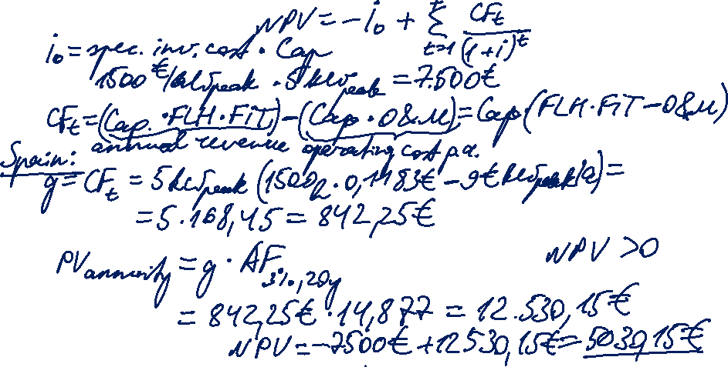
Task 3) NPV and Levelized
Cost of Energy (LCOE)
Description | Germany | Spain | Unit
Specific investment costs | 1 500 | 1 500 | €/kW_{peak}
Operation and maintenance (O&M) costs | 9 | 9 | €/kW_{peak}/a
Full load hours | 900 | 1 500 | hours/a
Capacity | 5 | 5 | kW_{peak}
Lifetime | 20 | 20 | a
Interest rate | 3 | 3 | %
The table describes the investment conditions for a 5 kW_{peak} PV system in Germany and in Spain:
What is the Net Present Value (NPV) of the investment in Spain and in Germany, given a feed-in tariff (FIT) of 11.83 ct/kWh?

Slide 20
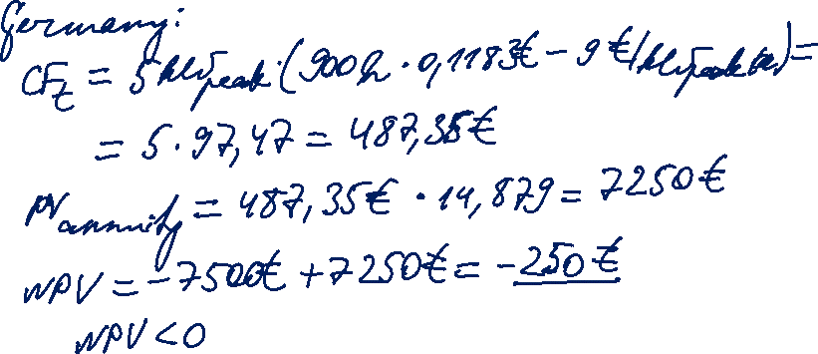
Task 3) NPV and Levelized
Cost of Energy (LCOE)
Description | Germany | Spain | Unit
Specific investment costs | 1 500 | 1 500 | €/kW_{peak}
Operation and maintenance (O&M) costs | 9 | 9 | €/kW_{peak}/a
Full load hours | 900 | 1 500 | hours/a
Capacity | 5 | 5 | kW_{peak}
Lifetime | 20 | 20 | a
Interest rate | 3 | 3 | %

Slide 21
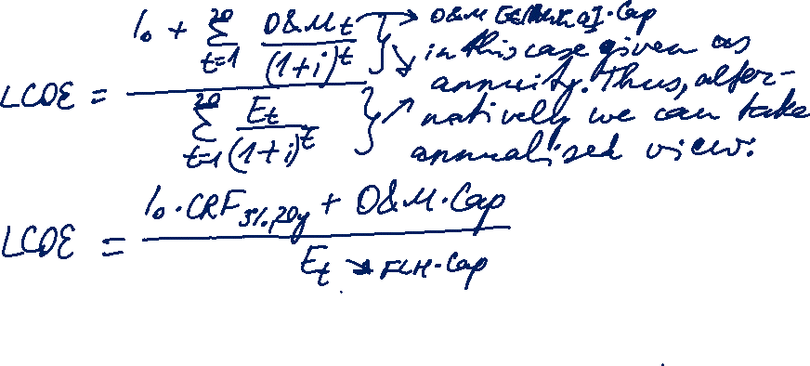
Task 3) NPV and Levelized
Cost of Energy (LCOE)
Description | Germany | Spain | Unit
Specific investment costs | 1 500 | 1 500 | €/kW_{peak}
Operation and maintenance (O&M) costs | 9 | 9 | €/kW_{peak}/a
Full load hours | 900 | 1 500 | hours/a
Capacity | 5 | 5 | kW_{peak}
Lifetime | 20 | 20 | a
Interest rate | 3 | 3 | %
The table describes the investment conditions for a 5 kW_{peak} PV system in Germany and in Spain:
What are the levelised cost of electricity (LCOE) of the photovoltaic system in Germany and in Spain (LCOE = electricity generation costs in ct/kWh based on full costing)?

Slide 22
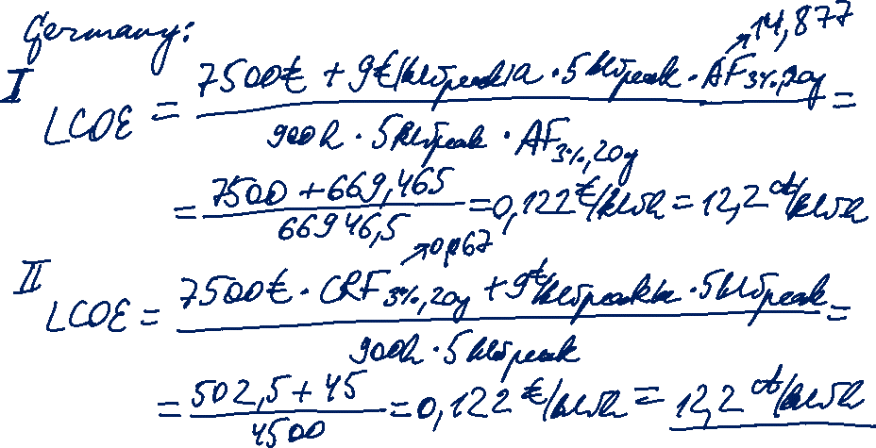
Task 3) NPV and Levelized
Cost of Energy (LCOE)
Description | Germany | Spain | Unit
Specific investment costs | 1 500 | 1 500 | €/kW_{peak}
Operation and maintenance (O&M) costs | 9 | 9 | €/kW_{peak}/a
Full load hours | 900 | 1 500 | hours/a
Capacity | 5 | 5 | kW_{peak}
Lifetime | 20 | 20 | a
Interest rate | 3 | 3 | %

Slide 23
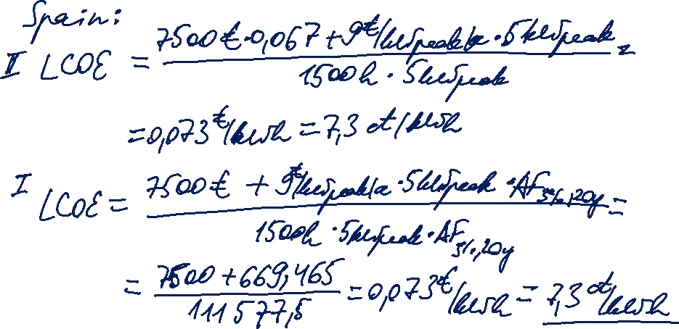
Task 3) NPV and Levelized
Cost of Energy (LCOE)
Description | Germany | Spain | Unit
Specific investment costs | 1 500 | 1 500 | €/kW_{peak}
Operation and maintenance (O&M) costs | 9 | 9 | €/kW_{peak}/a
Full load hours | 900 | 1 500 | hours/a
Capacity | 5 | 5 | kW_{peak}
Lifetime | 20 | 20 | a
Interest rate | 3 | 3 | %

Slide 24
Task 3) NPV and Levelized
Cost of Energy (LCOE)
Description | Germany | Spain | Unit
Specific investment costs | 1 500 | 1 500 | €/kW_{peak}
Operation and maintenance (O&M) costs | 9 | 9 | €/kW_{peak}/a
Full load hours | 900 | 1 500 | hours/a
Capacity | 5 | 5 | kW_{peak}
Lifetime | 20 | 20 | a
Interest rate | 3 | 3 | %
The table describes the investment conditions for a 5 kW_{peak} PV system in Germany and in Spain:
Assume that electricity retail prices in Spain and Germany are 29 ct/kWh. What does your result in b) imply for the self-consumption of the generated electricity?

Slide 25
Task 3) NPV and Levelized
Cost of Energy (LCOE)
Description | Germany | Spain | Unit
Specific investment costs | 1 500 | 1 500 | €/kW_{peak}
Operation and maintenance (O&M) costs | 9 | 9 | €/kW_{peak}/a
Full load hours | 900 | 1 500 | hours/a
Capacity | 5 | 5 | kW_{peak}
Lifetime | 20 | 20 | a
Interest rate | 3 | 3 | %
The table describes the investment conditions for a 5 kW_{peak} PV system in Germany and in Spain:
Assume that electricity retail prices in Spain and Germany are 29 ct/kWh. What does your result in b) imply for the self-consumption of the generated electricity?
The PV system operator is at the same time an electricity consumer (prosumer).
The operator have an option to cover their electricity demand either from
a supplier at the retail price (and feed the electricity generated in the PV system into the grid), or
the electricity generated in their PV system (self-consumption). For Germany: E_{t} = 4500 kWh
Alt. I. 1. cost of electricity from supplier: 4500 kWh * 0,29 €/kWh = 1305 €
2. revenue from feed-in (FIT): 4500 kWh * 11,83 ct/kWh = 532,35 € Total: -1101,15 €
3. LCOE: 4500 kWh * 7,3 ct/kWh = 388,5 €
Alt. II. 1. LCOE: 4500 kWh * 7,3 ct/kWh = 388,5 €
no cost of ext. consumption; no revenue from feeding into the grid; but additional costs:
green & CHP fee, electricity tax (but saves on grid fees) Total: -388,5 € plus fees
LCOE_{Spain} = 7,3 ct/kWh and LCOE_{Germany} = 12,2 ct/kWh are both below the retail price of 29 ct/kWh.
→ Self-consumption is preferred over buying electricity from the supplier (retail grid parity is reached).
Direct marketing?

