Slide 1
Energy Economics -Integrated Course
Sector coupling
Prof. Dr. Boris Heinz
Web: www.ensys.tu-berlin.de

Slide 2
Sector coupling
Survey:
What do you associate with the term "sector coupling"?
Is sector coupling the solution for energy system transformation?
Can we generate enough electricity to fully electrify the transport and heating sectors?

Slide 3
Sector coupling
What do you associate with the term "sector coupling"?
Coupling of energy and industry
Dependency of energy sectors
Efficient use of energy through linking of various sectors
Consider various energy sectors as linked (transport, heating, power, industry), i.e. power in heating or transport sector
Dependency of one sector from other sectors
Increase efficiency through usage of resources in various sectors

Slide 4
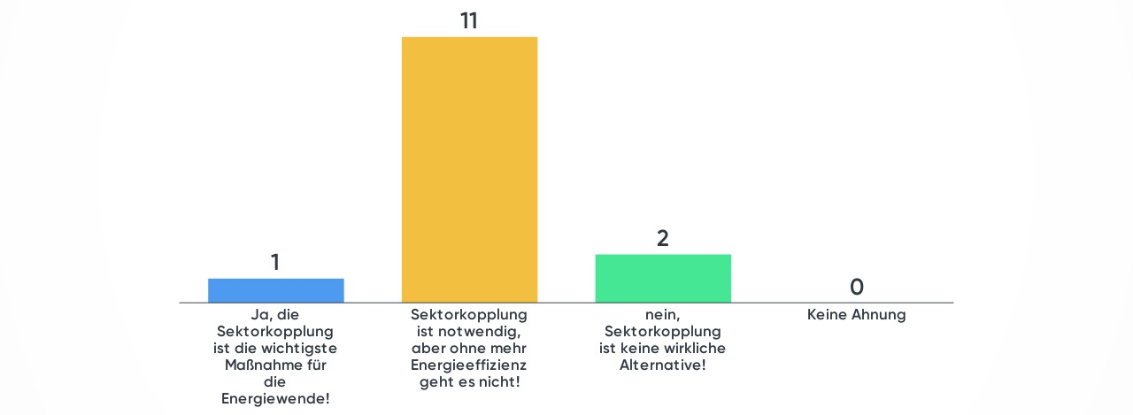
Sector coupling
Is „sector coupling“ the solution to the energy transition?
Yes, sector coupling is most important measure
Sector coupling is required, however not enough without energy efficiency
Sector coupling is no alternative
Don‘t know

Slide 5
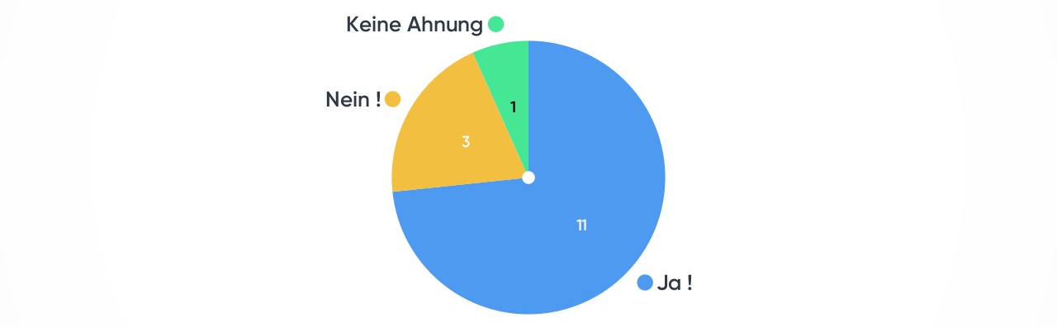
Sector coupling
Can we generate enough power to electrify the transport and heat sector entirely?
No idea
No
Yes

Slide 6
What is sector coupling?
"Sector coupling is intended to make a decisive contribution to the achievement of ambitious climate protection targets through the increased use of renewable electricity in the transport, heating and industry sectors to replace fossil fuels".
BMWi: "That's what it's all about: Use electricity from renewables to generate heat, cold and motive power. The goal is to replace fossil fuels."
Sectors: Electricity, heating, transport
-> Synonym: Electrification of the heating, transport and industrial sectors
Not a new idea, though:
Night storage heaters
Electric railway
But new demands: Sector coupling as a flexibility option, network service

Slide 7
Reference to sector coupling
Energy industry
Interest in sector coupling to develop new optimisation and business opportunities within a changing energy system
Exit from conventional energies to renewables
Science
Possibilities and concrete forms of a coupling of different sectors or subsystems from an ecological, economic, technical, regulatory and social science perspective

Slide 8
Key questions
How does sector coupling differ from existing couplings in the energy system and why is a new definition being developed?
How can sector coupling be defined and what statements can be made about central aspects of sector coupling?
What opportunities and potentials does sector coupling offer?
What challenges exist?

Slide 9
Perspectives
Technological, system and infrastructure perspective
Regulatory and legal perspective
Economic consideration of costs and revenue opportunities
Information and communication aspects
Supply and consumption side potentials
Practical implementation challenges, social science aspects

Slide 10
Sectoren
Electricity, heat and transport or mobility
Fossil energy sources dominate strongly and renewable electricity hardly used
coupling of (sub-)energy systems, rather than actual linking of sectors
Novel interlocking of the classical consumption sectors of the energy industry (households, trade, commerce, services, industry, transport)
As well as, energy sources and final energy forms (electricity, heat/cooling and fuels)
As well as the infrastructures linked to them (electricity networks, gas networks, heat networks, information and communication networks)
Also, other renewables apart from electricity, such as biomass for the production of synthetic fuels (hydrogen), use of solar thermal energy in heating networks

Slide 11
Coupling elements
General
Coupling or infrastructural interlocking of different
Energy sources
Forms of energy
Parts of energy systems
In the transformation sector at the secondary energy level, and coupling of different consumption sectors in the transition from secondary energy to final energy
Energy transition (Germany) currently rather an electricity transition
Sector coupling as an aid to complement energy transition, taking transport and heat sectors in
Objective: Comprehensive decarbonisation of all partial energy systems

Slide 12
Coupling elements
Source: ScienceDirect

Slide 13
Coupling elements
Renewable energy sources (wind, PV, biomass, solar or geothermal energy, ...) replace fossil energy sources in new applications
Direct use of electricity
Power-to-X (PtX) power conversion
synthetic fuels (power-to-gas, power-to-liquid)
Heat/Cold (Power-toHeat)
Excess power
Transmission network bottlenecks
Power-to-X as conversion of electricity as primary energy into an energy source, heat, cold, fuel or raw material
Power-to-X as synonym of sector coupling
Those: Wietschel et al. (2018)

Slide 14
Sector coupling examples
Source: Semantic Scholar

Slide 15
Technologies
Source: Wiley

Slide 16
Broad def. sector coupling

Slide 17
Hydrogen and sector coupling

Slide 18
Power to X

Slide 19
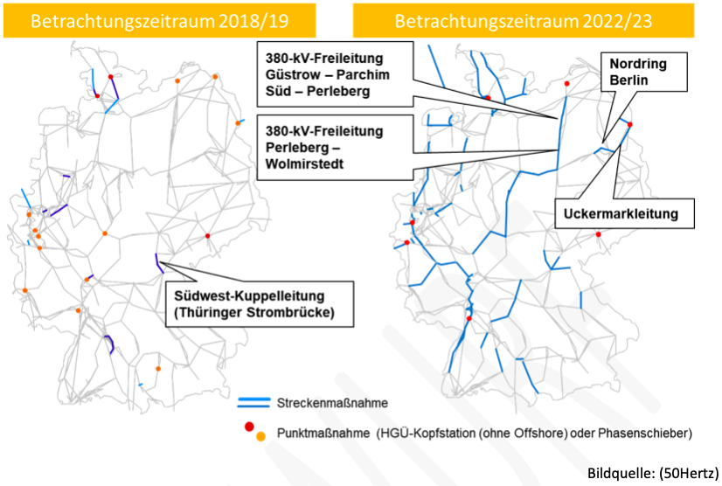
Power to X
Prevention & elimination of network bottlenecks
Examination of the potentials of power-to-heat systems for the prevention and elimination of grid bottlenecks in the transmission grid

Slide 20
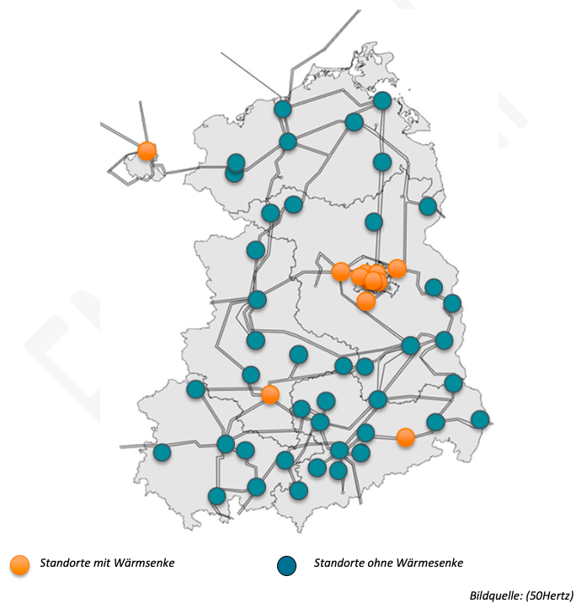
Power to X
-Standorte

Slide 21
Electrification of the heat sector

Slide 22
How can the heat transition work out?
Efficiency
measures
Graph by Agora 2016
Building-related renewable energy potentials

Slide 23
How can the heat transition work out?
Remaining heat demand that cannot be covered by efficiency measures and building-related renewables
Sector coupling: Renewable electricity replaces fossil fuels in the heat sector
Power-to-Heat
Heat pumps
Direct electric heating
Into future: power-to-gas (methane or H2)? CHP and fuel cells?

Slide 24
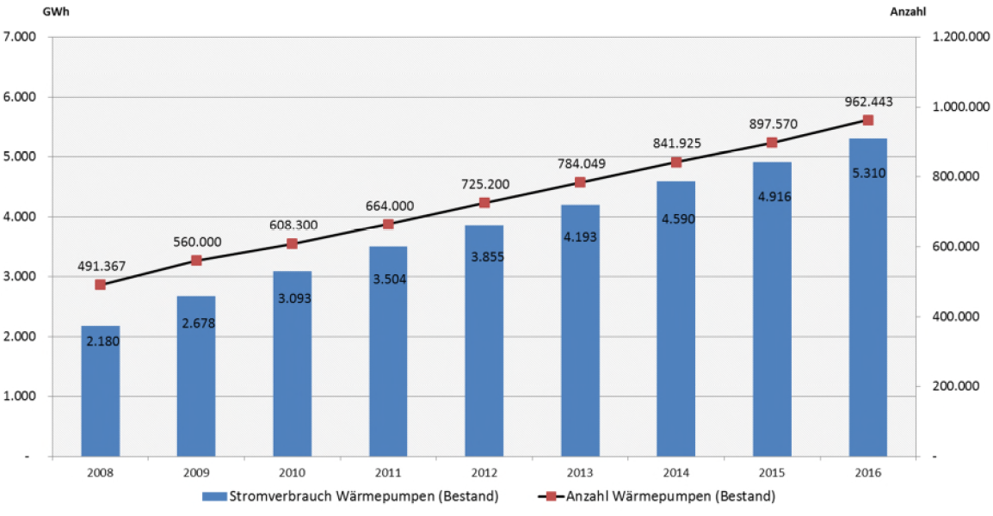
Power-to-Heat in Germany
Number and electricity consumption of heat pumps
Source: Monitoringbericht 2018
Net and final energy demand heat 2008: 850 TWh (Agora, 2016)

Slide 25
Power-to-Heat in Germany
Development of the cumulative plant output of electric boilers and annual additions
Net and final energy demand heat 2008: 850 TWh (Agora, 2016)
Source: P2X@BerlinAdlershof

Slide 26
Power-to-Gas in Germany
Development of cumulated electrical input and gas production capacity
Datenquelle: www.powertogas.info, Stand April 2017
Primary energy consumption natural gas 2015: 770 TWh (AGEB, 2016)

Slide 27
Electrification of the transport sector

Slide 28
How can the traffic transition work?
E-Mobility?
Regeneratively produced fuels (liquid or gaseous)?
Alternatives
Shift to rail?
Improved public transport?
Traffic avoidance?
But
Rising number of cars, increasing mileage per car, increasing energy consumption in the transport sector for years!
Lack of alternatives for air transport?

Slide 29
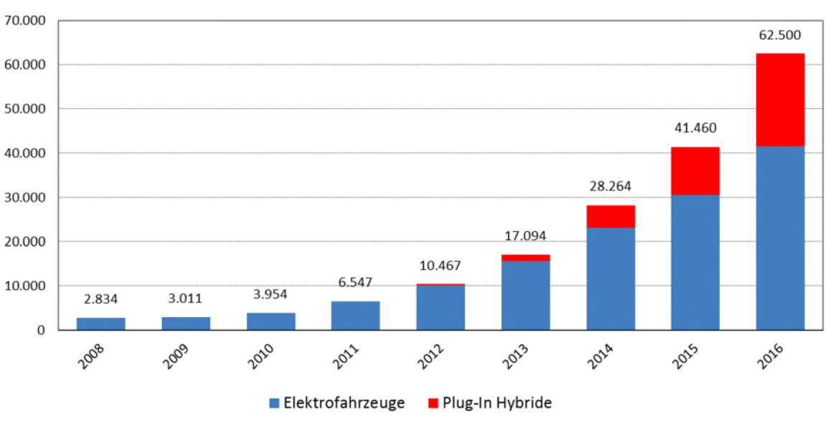
E-Mobility in Germany
Stock of electric vehicles
Source: Monitoringbericht 2018
However: about 45 million passenger cars in Germany

Slide 30
Economic efficiency of sector coupling

Slide 31
Economic efficiency of sector coupling
Investment and operating costs of the sector coupling technology depending on:
Efficiency of the sector coupling technology
Price of the substituted energy source to be invested
Electricity purchasing cost
Further obstacles?

Slide 32
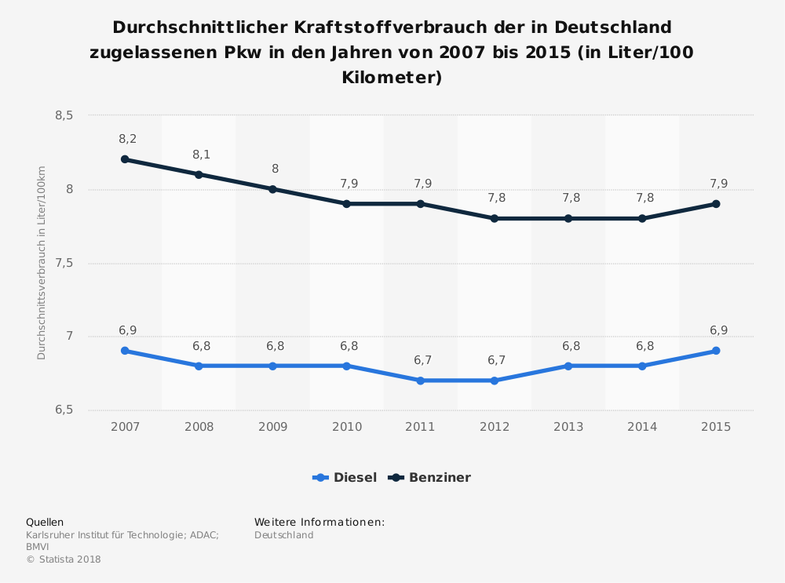
Mobility transition
Is electricity as a fuel an economic alternative?

Slide 33
Verkehrswende
Is electricity as a fuel an economic alternative?

Slide 34
How is electrictiy produced?

Slide 35
How is electricity produced?
With an increasing share of volatile RES generation, more frequent hours during which renewable electricity generation exceeds the load.
negative residual load
Sector coupling technologies as additional demand in the electricity market
Market-driven regulation of RE plants is prevented

Slide 36
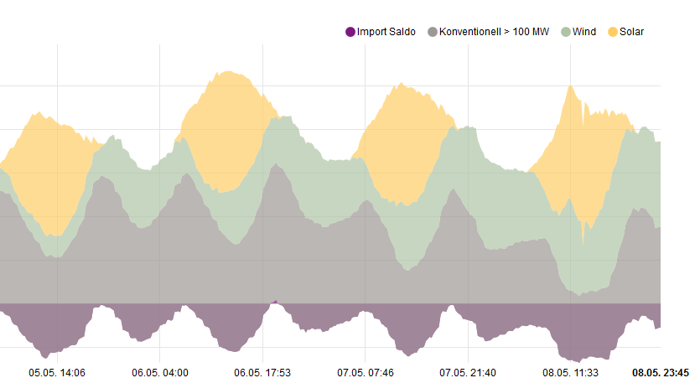
Renewable generation already reaches high share in many cases
Power generation mix (5.5.- 8.5.2016)
Source: www.energy-charts.de

Slide 37
Spot markets for electricity
(effective market) In the future: high shares of renewable energy
Covered by
Controllable generation
Storage (discharge)
Load
RES-Generation
Demand
Residual load
Excess
Uptake by
Storage (Charging)
Additional consumption: sector coupling

Slide 38
Day-Ahead-Markt - Situation 2015
Source: EPEX 2016

Slide 39
Day-Ahead-Markt - Situation 2015
4.145 h
653 h
126 h
Source: EPEX 2016

Slide 40
Day-Ahead-Markt - Situation 2015
127.2 TWh
23.3 TWh
4.8 TWh
Economic sector of, for example, electric boilers
~ 0 TWh
Datenquelle: EPEX 2016

Slide 41
Negative day-ahead prices in Germany [Data source: EEX].
Year | Number of hours with electricity price ≤ 0 | Min. price electr. [Euro/MWh]
2010 | 12 | -20,45
2011 | 16 | -38,82
2012 | 58 | -221,99
2013 | 65 | -100,93
2014 | 64 | -65,03
2015 | 129 | -79,94
2016 | 98 | -130,09

Slide 42
Transmittion network services
Control power
- Removal of network bottlenecks-
In principle, sector coupling technologies can adapt their consumption as flexible loads and thus provide negative balancing energy or help to eliminate grid bottlenecks.
But: not all sector coupling technologies are equally suitable!
High investment costs require high full load hours
Wear during start-up and shut-down leads to high operating costs
Performance difficult to maintain
Technical flexibility not sufficient

Slide 43
Control power
Short time frame (next hour)
Higher power consumption than generation leads in the first step to reduction of the grid frequency (50Hz)
... and in the absence of corrective action to blackouts:
July 30th, 2012: India, 670 millions people
August 13th, 2003: Ontario and North America, 50 millions people
November 4th, 2006: UCTE, 15 millions people
⇒ Minute-by-minute monitoring and assessment of the balance between consumption and production
Transmission system operator (TSO) responsible for security of supply and reliability
TSO eliminates differences between consumption and generation

Slide 44
Mechanisms – Control power
Control energy reserve is a generation unit that can be activated at short notice
Reserves vary according to activation time and are divided into three types:
Primary: response time ≤ 20s. Automatic devices
(Primary control energy - is needed to quickly stabilize the grid within 30 seconds)
Secondary: response time ≤ 3min Automatic
(secondary balancing energy must be available in full within five minutes)
Tertiary: response time ≤ 15mn. Manuel
(Tertiary reserve is used to replace the secondary control energy, is provided with a lead time of down to 7.5 minutes and is called up at a constant level for at least 15 minutes)
-- The use and extent of each reserve varies depending on the incident --

Slide 45
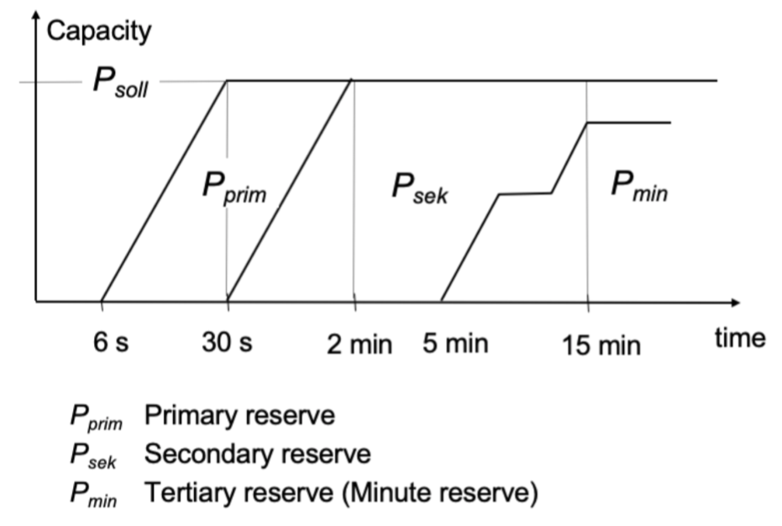
Control power reserves

Slide 46
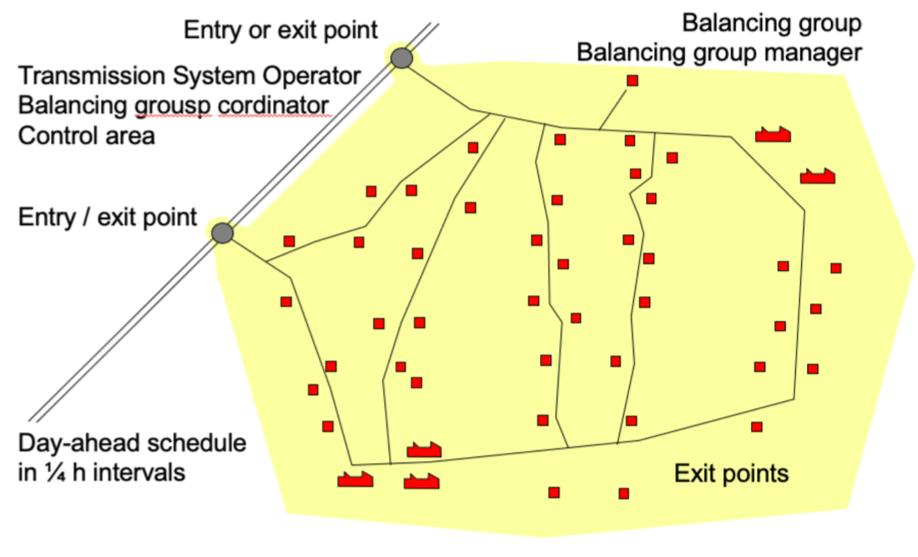
Terminologies 1

Slide 47
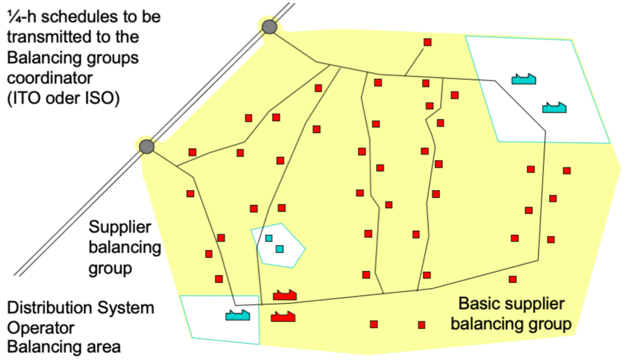
Terminologies 2

Slide 48
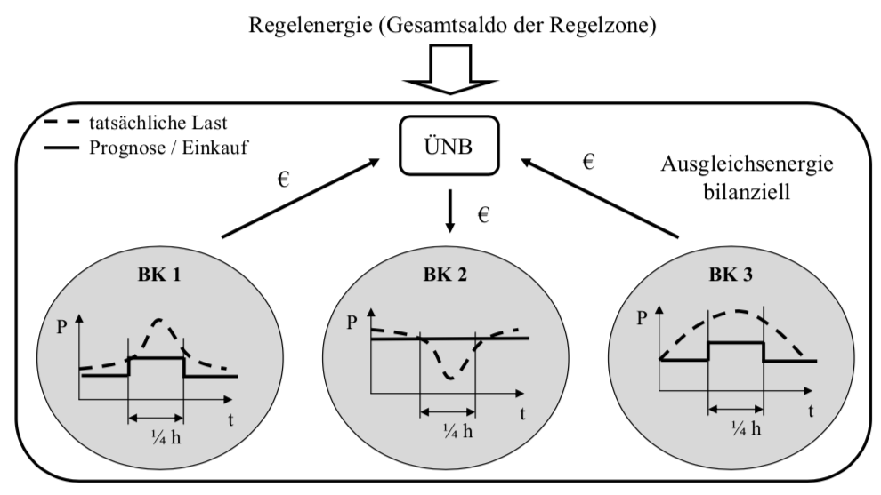
Balancing and control energy

Slide 49
Usage of negative control power
Datenquelle: BNetzA 2015, 2016

Slide 50
Control power output price development [Source: calculated from www.regelleistung.net]
Year | Scondary Euro/(MW-h) |  | Tertiary Euro/(MW-h)
 | positive | negative | positive | negative
2010 | 10,67 | 12,87 | 1,11 | 3,18
2011 | 8,08 | 10,89 | 0,30 | 4,29
2012 | 2,37 | 10,92 | 0,61 | 3,01
2013 | 7,87 | 11,83 | 0,94 | 5,72
2014 | 7,83 | 5,16 | 0,55 | 4,02
2015 | 6,07 | 2,63 | 0,60 | 1,86

Slide 51
Political situation in Germany

Slide 52
Power in 2030 „paper“
www.bmwi.de; Stand September 2016

Slide 53
Long-term trends and tasks for the coming years in the perspective of the BMWi
Impulse paper "Electricity 2030" of the BMWi, September 2016
The Electricity Market Act lays the foundation for the electricity market 2.0. It creates competition between flexibility options and ensures that the electricity supply remains secure and cost-effective with a high proportion of renewable energies (p. 3)
After electricity market liberalisation and electricity market 2.0, the next item on the agenda is energy market 2.0. The aim is to replace fossil fuels as far as possible with efficiently used renewable electricity (p. 3)
To this end, the regulatory framework must be further developed to improve the competitive conditions for wind and solar power in the heating and transport sectors (p. 3)

Slide 54
Renewables or "Efficiency First"?
Impulse paper "Electricity 2030" of the BMWi, September 2016
"Efficiency First: taking electricity efficiency into account in all energy policy decisions [...]" (p. 18)
"Power efficiency impacting sector coupling. The increased use of electricity for heating and mobility is leading to a significant rise in the overall demand for electricity. A massive increase in efficiency limits this increase to the necessary extent" (p. 18)

Slide 55
Sector coupling and surplus electricity
Impulse paper "Electricity 2030" of the BMWi, September 2016
Enabling efficient load connection for electricity from renewable energies! "The temporary connection of sector coupling technologies [...] can be useful", namely in times "when there is a lot of electricity from renewables in the grid and the electricity prices on the stock exchange are negative" (p. 20)
"How can a reasonable cost allocation for renewable electricity be achieved in the other sectors?" (S. 20)
"Those sectors that reduce their _{CO2 emissions} through the use of RES-E contribute adequately to the financing of the energy system (polluter pays principle)" (p. 10)

Slide 56
Thoughts
Can we generate enough electricity to fully electrify the transport and heating sectors?

Slide 57
Thoughts

Slide 58
Thoughts

